Slide 1
DXS Optics Simulation
Nan Wang, Apr 30th 2021

Slide 2
Outline
Crystal heat-load deformation
Strehl ratio
HRM tolerance scan (some issues)
HRM-Mir optimization

Slide 3
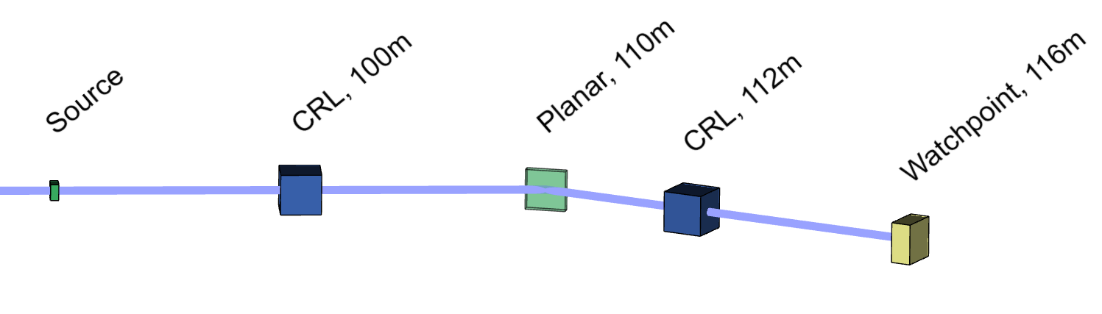
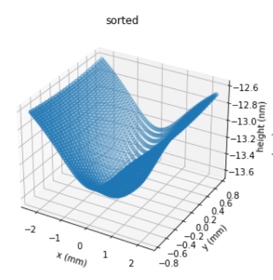
Deformation
Crystal deformation is simulated as the height error for a flat mirror. For a 250um (FWHM) beam profile, the RMS height error is ~88.7 pm at 70W.

Slide 4
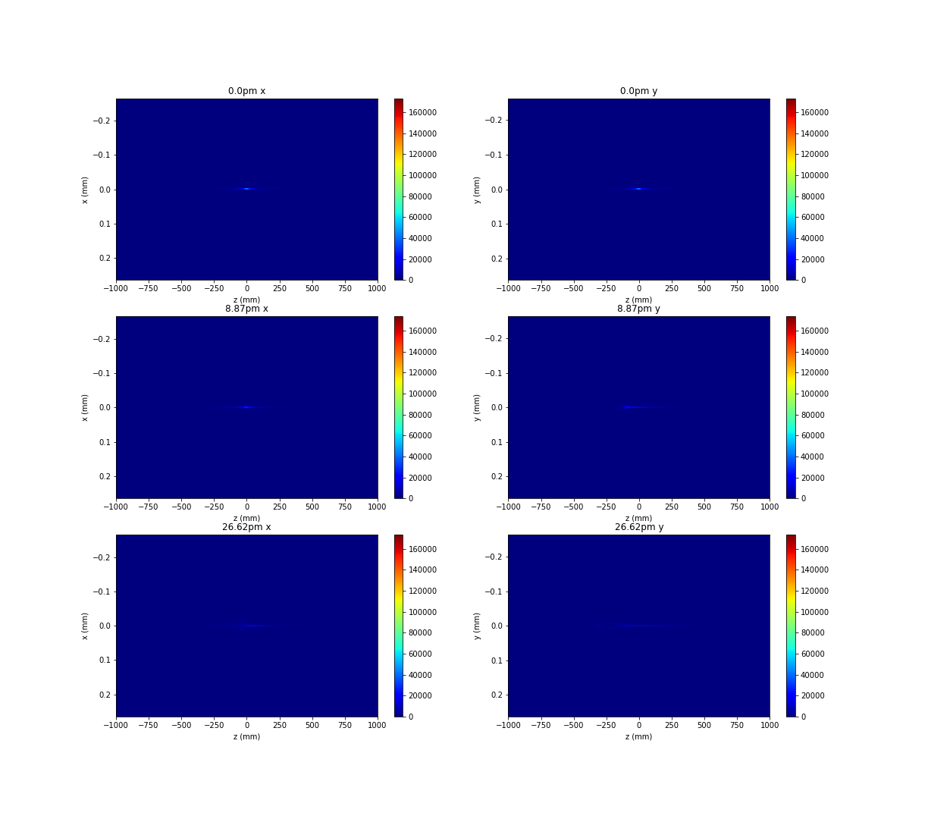
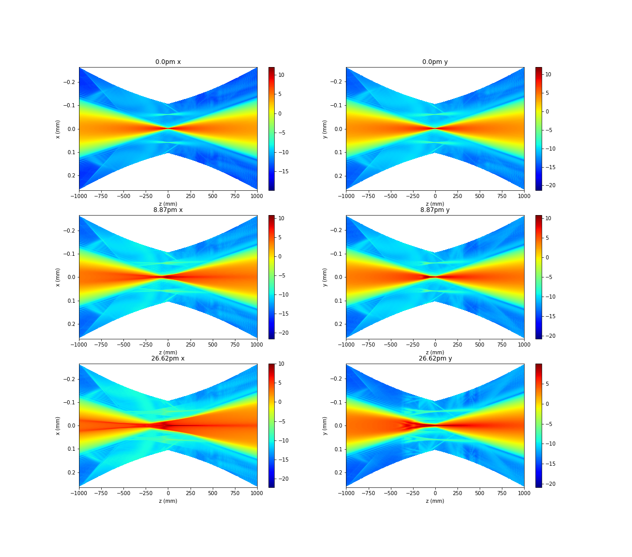
Beam profile vs height error

Slide 5
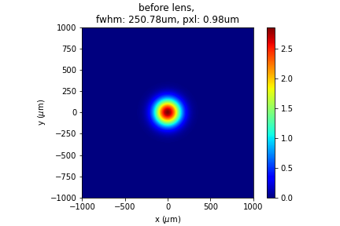
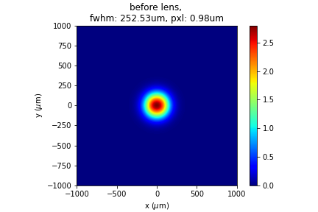
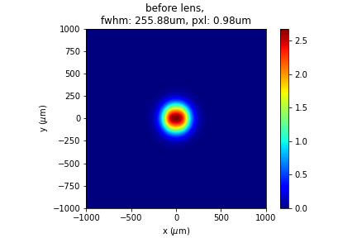
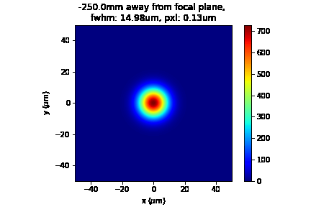


Around focal plane, ±25cm
flat mirror
8.87pm
26.62pm

Slide 6
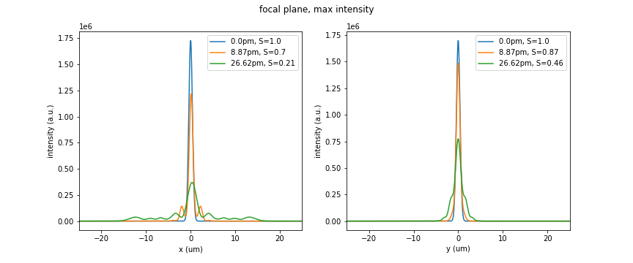
Strehl ratio
The theoretical Strehl ratio for the three cases are: 1.0, 0.952, 0.643 respectively. The simulated value is smaller due to astigmatism. Working on correction with 1D CRL.

Slide 7
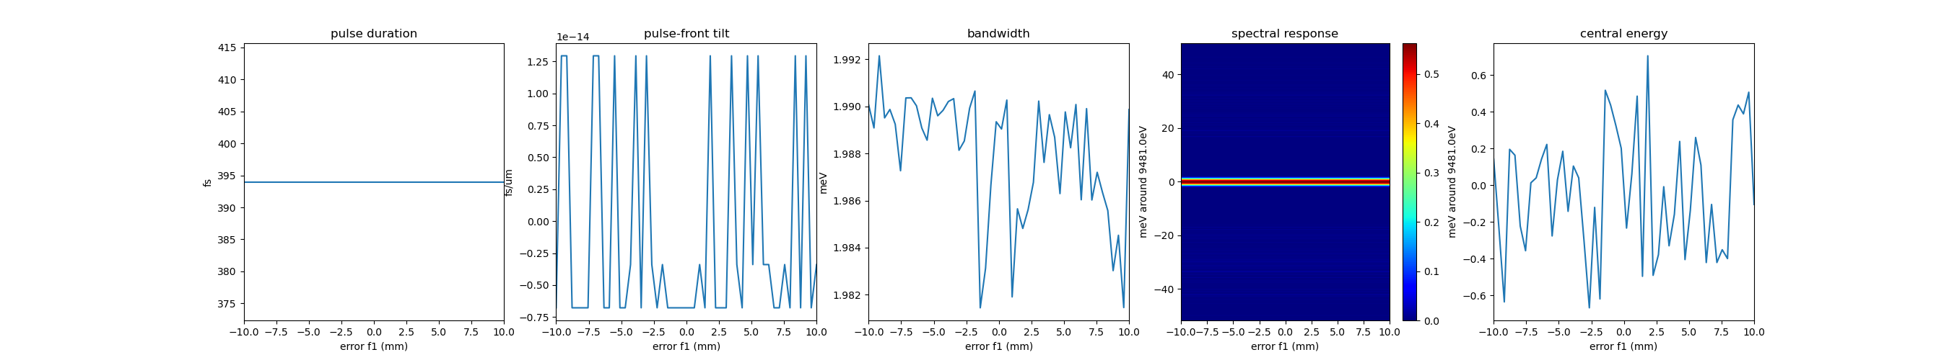
Crystal-lens distance

Slide 8
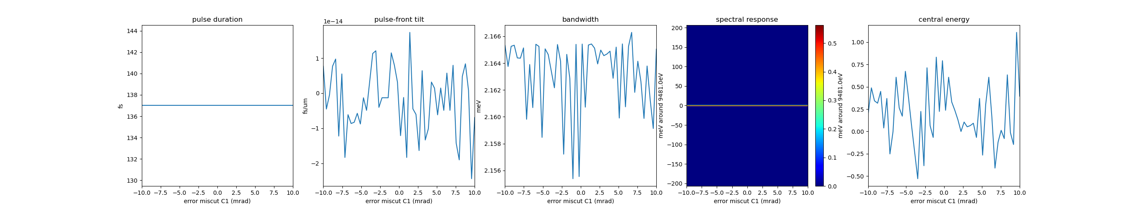
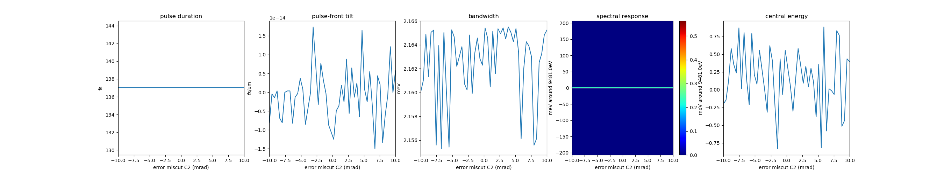
Crystal miscut error, C1, C2

Slide 9
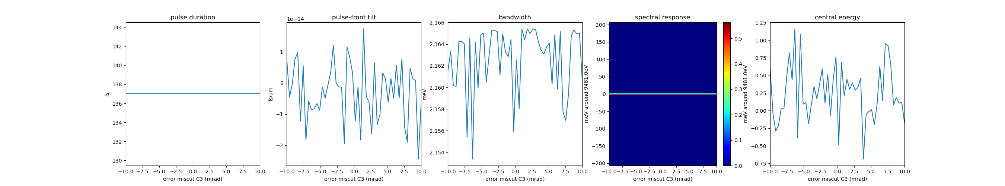
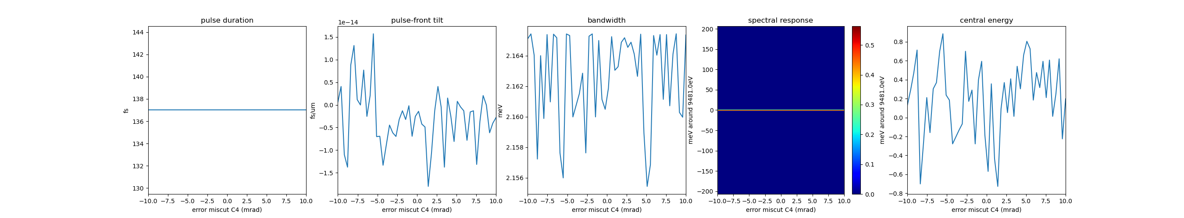
Crystal miscut error, C3, C4

Slide 10
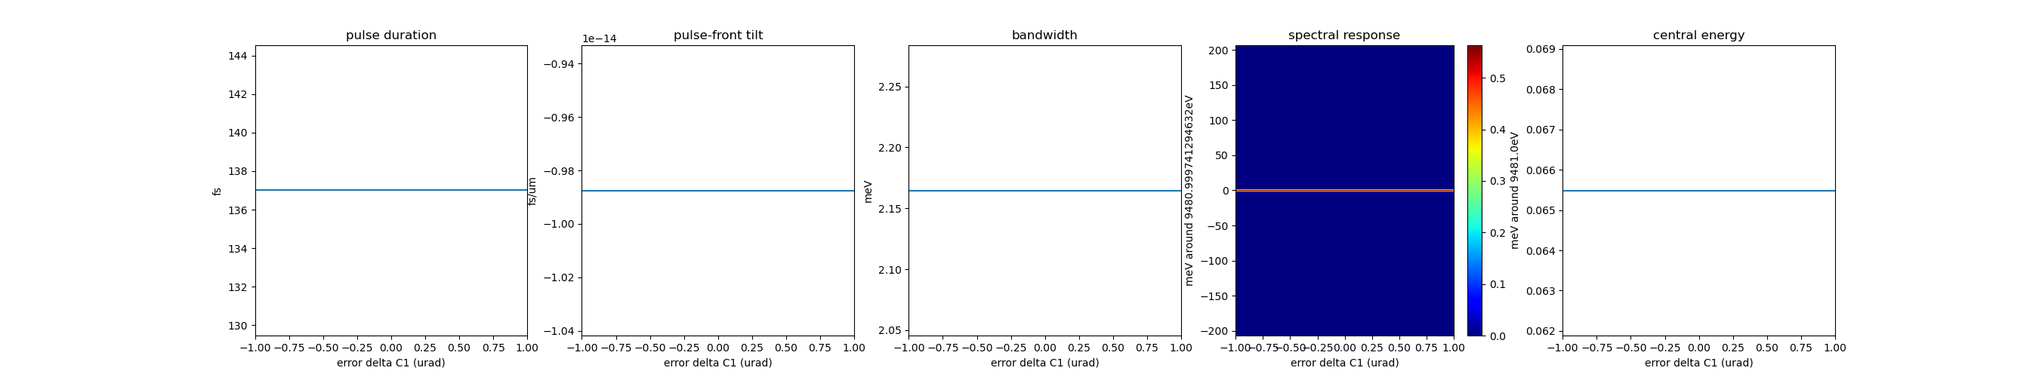

Crystal alginment error, C1, C2
I’m certain that the parameters were changed in the simulation.

Slide 11


Crystal alignment error, C3, C4
I’m certain that the parameters were changed in the simulation.

Slide 12
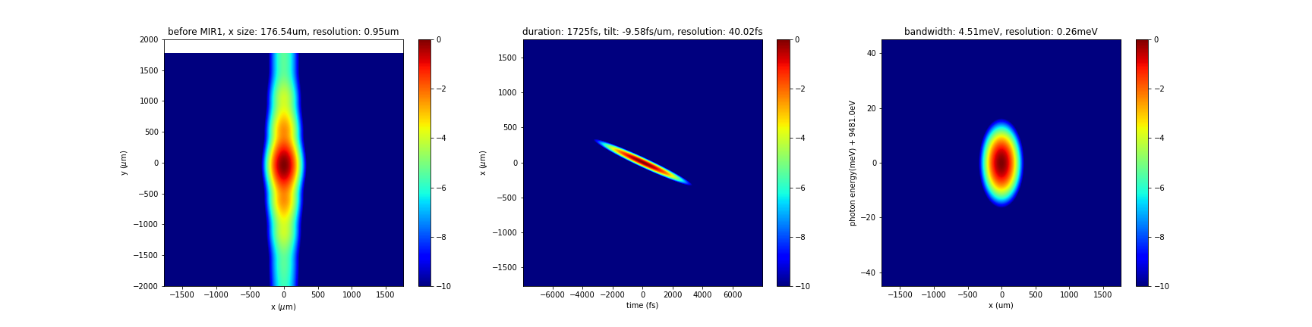
HRM Mirror, before mirror 1

Slide 13
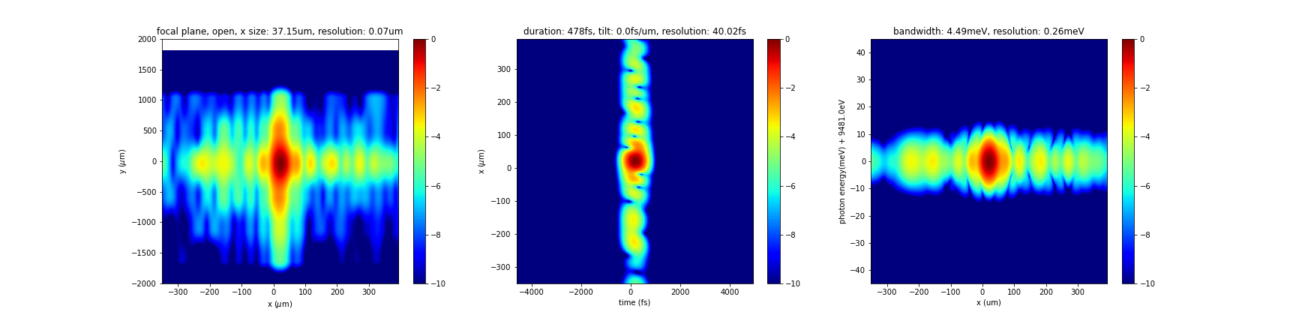
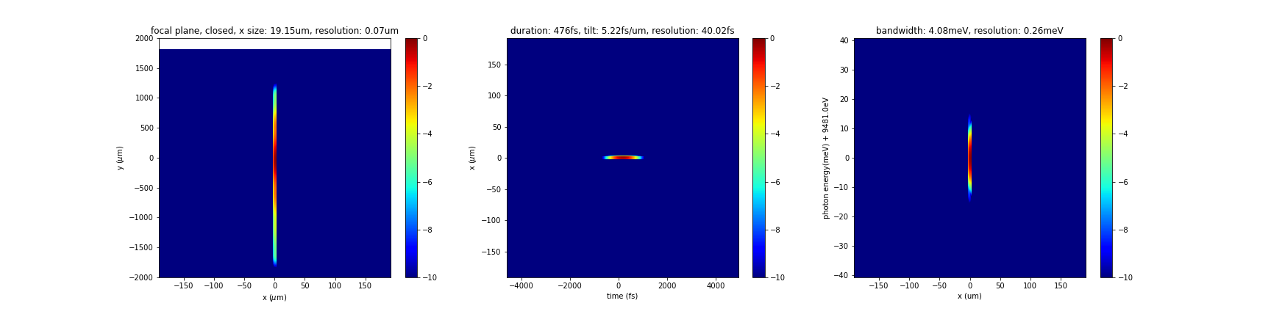
HRM Mirror, focus

Slide 14
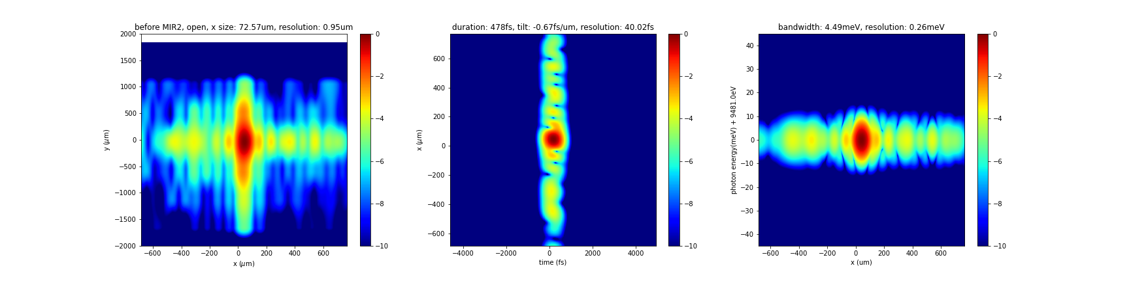
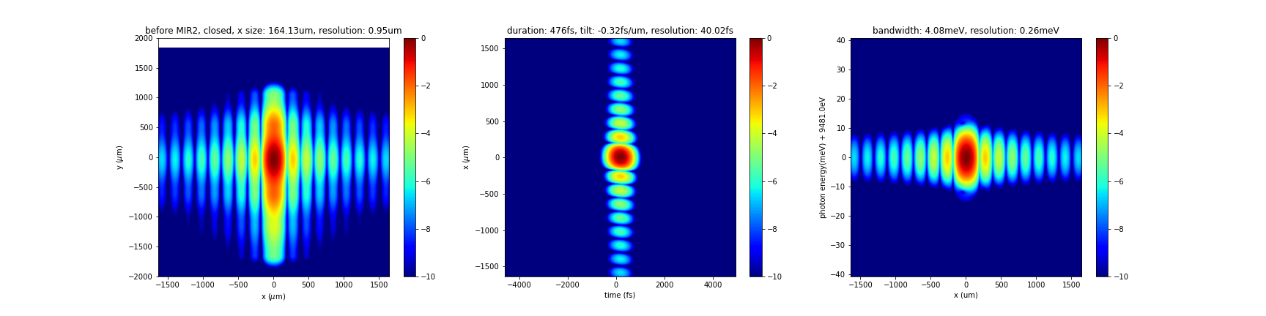
HRM Mirror, before mirror 2

Slide 15
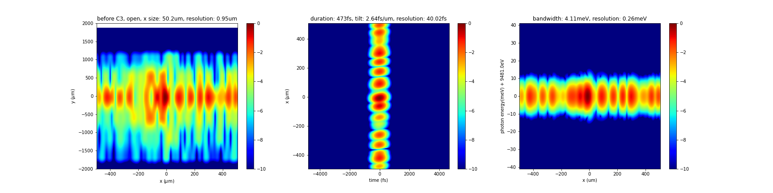

HRM Mirror, before C3

Slide 16
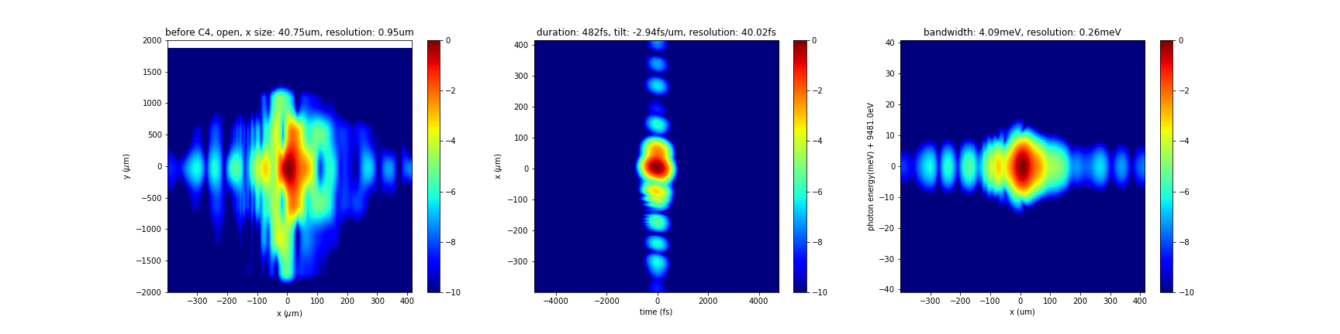
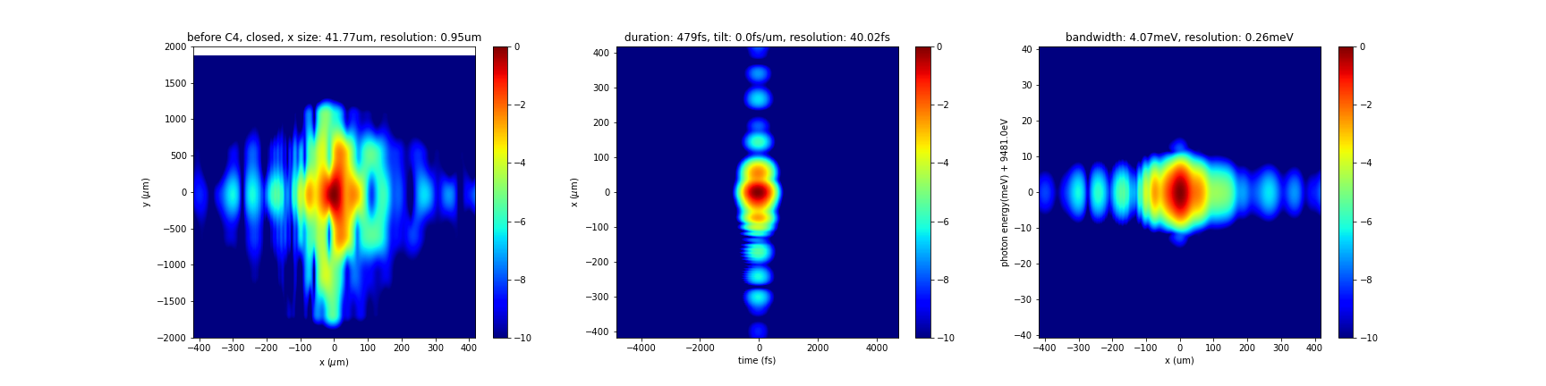
HRM Mirror, before C4

Slide 17
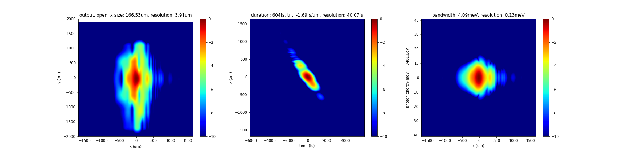
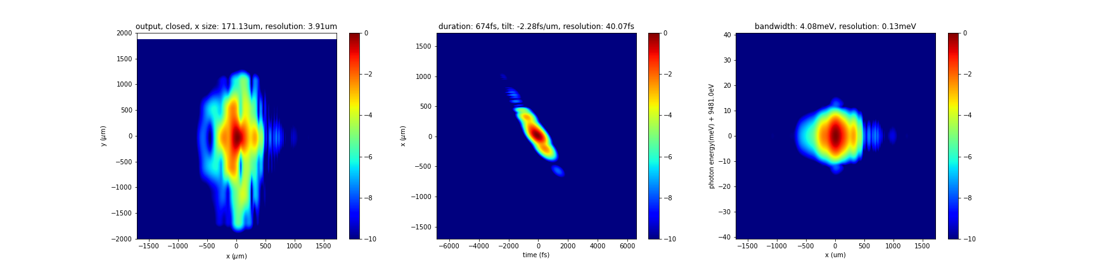
HRM Mirror, output

Slide 18
To-do
Email Jana and ask for help in terms of visualizing large datasets not in the middle of propagation but after finished, or extracting a small amount of data to plot.
Linear scale plots might be more meaningful
Compare lens and mirror cases (linear/log both)
Subtract quad fit then calculate Strehl ratio, do this for lower power deformation; Now wants to get highest power limit for focus around focal spot to look normal
Want extreme (40W), lower, daily (10keV, 20W) power results.

